Slide 1
A Comparative Study of Wiener Process and Geometric Brownian Motion
FINANCIAL
710882199 - Enzo HAEGEL
COMPUTING

Slide 2
Wiener Process
The Wiener process, also known as a Brownian motion process, is a mathematical model used in various scientific fields such as physics, economics, and engineering. It's a type of stochastic (random) process named after Norbert Wiener, an American mathematician.

Slide 3
Geometric Brownian Motion
GBM stands for Geometric Brownian Motion. It's a continuous-time stochastic process that's used in many areas, but particularly in mathematical finance. The Geometric Brownian Motion model serves as the foundation for various option pricing models, including the renowned Black-Scholes model.
The GBM is often used in finance to represent the evolution of stock prices or other securities because it assumes that price changes are normally distributed (as in the Wiener process), and it never drops to zero (because of the geometric, exponential nature of the process).

Slide 4
The goal
Introduction
The goal is to do a comparison between two stochastic processes, the Wiener process (also known as Brownian motion) and the Geometric Brownian Motion using MATLAB

Slide 5
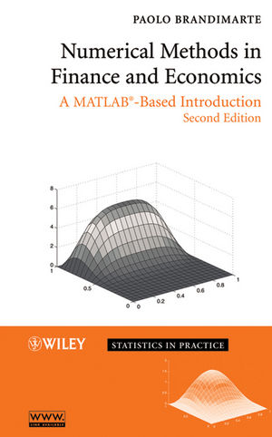
About
the project
Firstly, for this project I used the examples 2.19 and 2.20 from the textbook Numerical Methods in Finances and Economics, A MATLAB-Base Introducion from Paolo BRANDIMARTE. To modeling the dynamics of asset prices.

Slide 6
The method
To perform the comparison, 1000 paths for each process were generated with a time step, dt = 0.01, for a time horizon, T = 1.

Slide 7
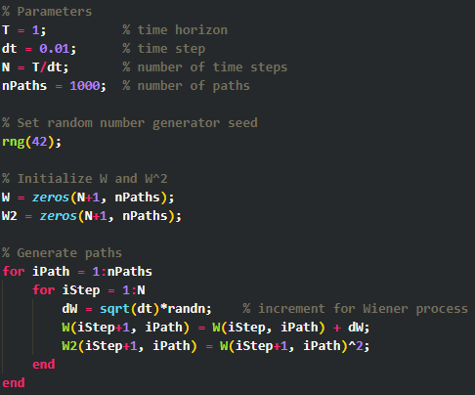
Wiener process
Initialize:
W(0) = 0, and W²(0) = 0 for each path.
For each path (1 to `nPaths`), we perform the following steps:
For each time step from 1 to `N`, we calculate:
An incremental change, dW, which is drawn from a normal distribution with mean 0 and standard deviation sqrt(dt), i.e.,
dW ~ N(0, sqrt(dt)).
The value of the Wiener process at the current time step, i.e.,
W(t+dt) = W(t) + dW.
The square of the Wiener process at the current time step, i.e.,
W²(t+dt) = (W(t+dt))².

Slide 8
Wiener process
This can be represented in mathematical equations as follows:
W(0) = 0, W²(0) = 0
For each path p in {1, ..., nPaths}, do the following for each time step t in {1, ..., N}:
dW = sqrt(dt) * ξ, where ξ ~ N(0,1)
W(t+dt) = W(t) + dW
W²(t+dt) = (W(t+dt))²
Here, ξ is a random variable following a standard normal distribution, ‘N(0,1)’ represents it with mean 0 and standard deviation 1.

Slide 9
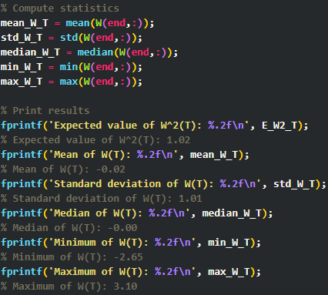
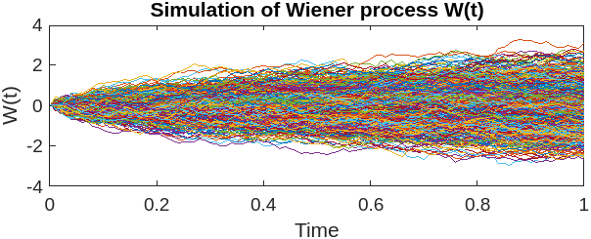
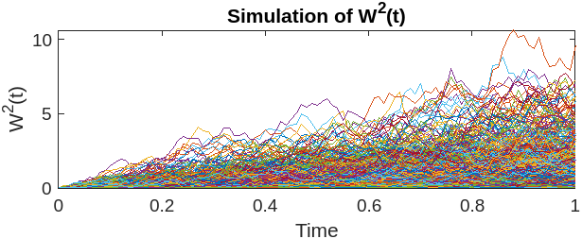
Result

Slide 10
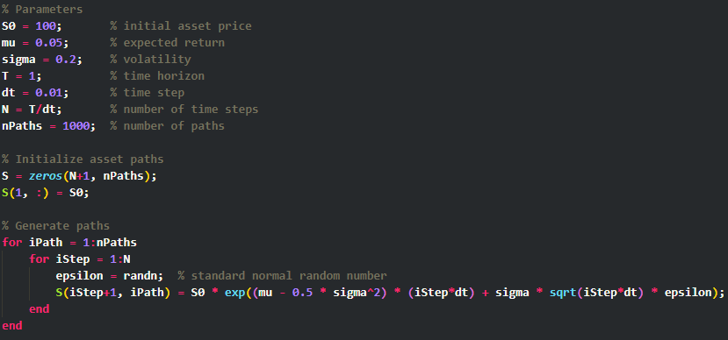
GBM
Initialize:
S(0) = S0 for each path.
For each path (1 to nPaths), we perform the following steps:
For each time step from 1 to N, we calculate:
epsilon is a standard normal random number, i.e.,
ε ~ N(0,1).
The value of the asset price at the current time step is given by:
S(t+dt) = S0 * exp((mu - 0.5 * sigma²2) * (tdt) + sigma * sqrt(tdt) * ε)

Slide 11
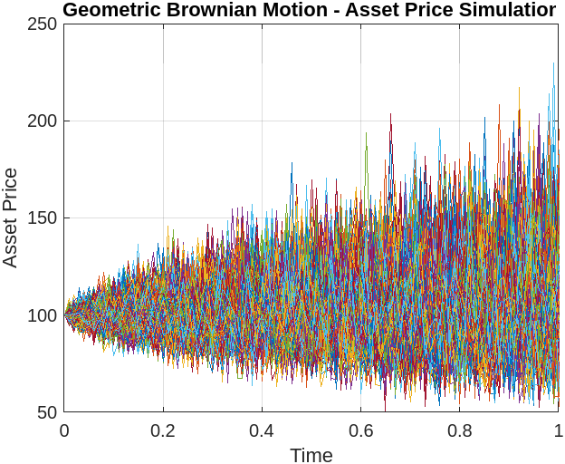
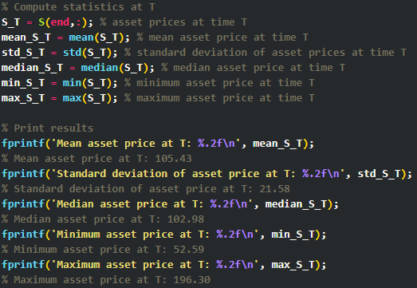
Result

Slide 12
Wiener Process
The Wiener process is a powerful model for phenomena with random fluctuations.
Our simulation confirmed theoretical expectations: W²(T) ≈ 1 and the process W(T) is normally distributed around zero.

Slide 13
Geometric Brownian Motion
GBM is an effective model for representing asset price dynamics in financial markets.
Our simulation showed considerable variability in asset prices: Mean ≈ 105.43, Standard Deviation ≈ 21.58, with prices ranging from 52.59 to 196.30.

Slide 14
Conclusion
Both the Wiener process and GBM serve as valid mathematical models for their respective applications.
Choice between these models depends on the situation - use Wiener for random fluctuations around a mean and GBM for relative changes like asset prices.

Slide 15
Thank you!

